Slide 1

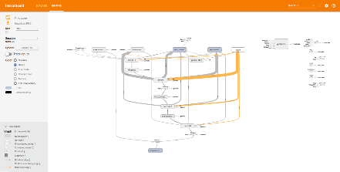
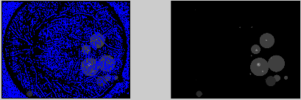
Improvement on the Task of Detecting Eye Lesion Mircoaneursyms using Deep Convolutional Neural Networks Rebecca D’Agostino Pace University
Results and Conclusion
Bibliography
Introduction
Methods
Convolutional Neural Networks are very useful for image classification and recognition tasks. [1] A convolutional
deep neural network was used in this application to detect Micoaneursyms that can lead to the diagnostics of diabetic retinopathy. The key limiting factor in this task is the lack of data, and was the case in this research.
Figure 1. Model used in research
The model was created using Python and the Tensorflow library. Pandas and numpy library was also used in order to structure the data.
The model structure is shown to the left.
Data was generated by using Matlab and the DIATAB1 database. Patches were cut to 25 x 25 windows. Of the images, 11-79, and 1-5 with 80-84 of them were used for training and evaluation respectfully, and the rest were used for testing. Whiting was also preformed to try to produce better result.
The model is not able to preform to expected benchmarks. This may be due to a number of factors, such as lack of data, model structure, or other unseen factors.
Other works that have been done have shown that deeper models are needed, and they have data that is much more extensive than the data used in this project. [2] [3]
More work is needed in order to conclude if it is an issue of the model, data, or both.
Figure 2. Model performance
[1]J. Schmidhuber, “Deep learning in neural Networks: An overview, vol 61. pp 85-117“Neural Networks. Jan. 2015.
[2] G. Lim, M. L. Lee, et al., “Transformed Representations for Convolutional Neural Networks in Diabetic Retinopathy Screening,” AAAI-14. Jan 14.
[3] H. Pratt, F. Coenen, et al. “Convolutional Neural Networks for Diabetic Retinopathy,” Procedia Computer Science, vol 90. pp. 200-205. July 2016.

